Slide 1

LexGuard: AI-Powered Contract Risk Analysis Platform
Democratizing Legal Understanding through Advanced Natural Language Processing

Slide 2
What is LexGuard?
LexGuard is a revolutionary web-based platform designed to democratize legal understanding by making complex contracts accessible to non-experts. In today's world, legal agreements govern nearly every aspect of our professional and personal lives—yet most people lack the resources to properly understand them.
Core Capabilities
Automated Parsing: Ingests and processes legal documents in PDF and DOCX formats instantly
Risk Identification: Detects high-risk terms and hidden liabilities buried in fine print
Unlike standard text search tools that only look for keywords, LexGuard utilizes Artificial Intelligence to understand semantic context and relational dependencies between different legal clauses. This means the platform doesn't just find words—it understands how different sections of a contract interact with and influence each other.
Plain-English Translation: Converts complex legal jargon into simple, understandable language
Contextual Analysis: Maps relationships between clauses to reveal hidden implications

Slide 3
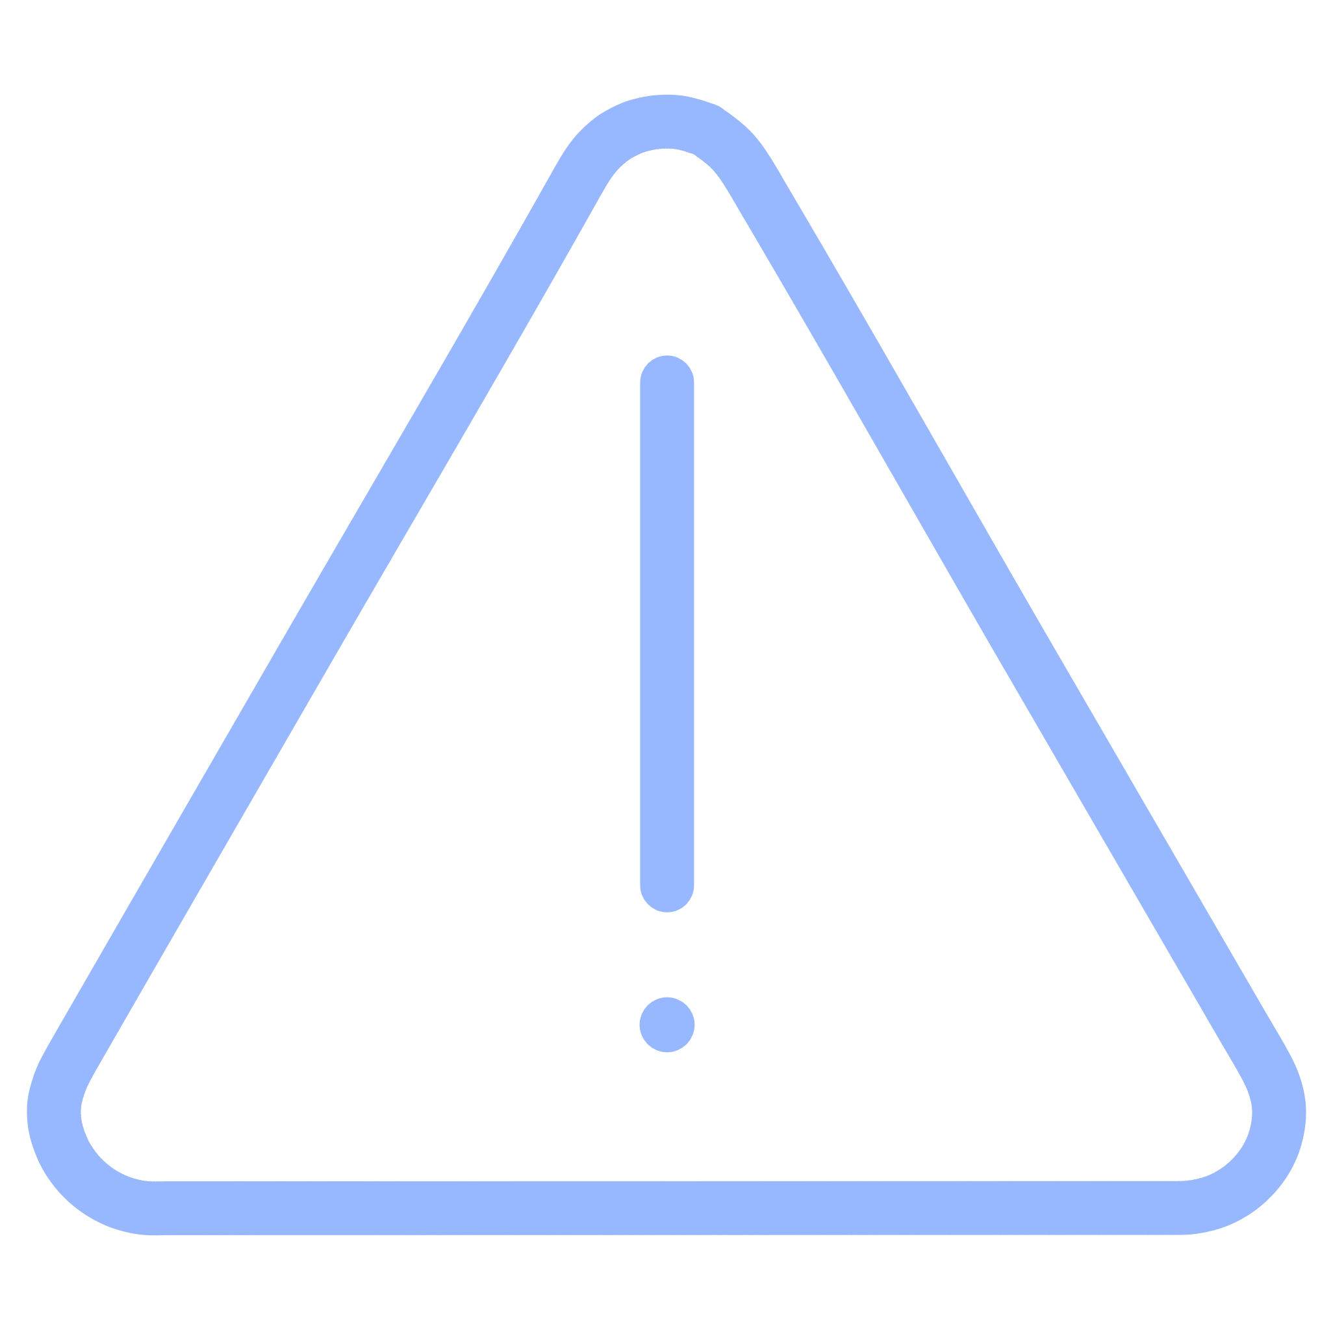
PROBLEM STATEMENT
Why LexGuard is Essential
The Legalese Barrier
Financial Accessibility Crisis
The proliferation of complex legal agreements creates significant risks for individuals and small businesses who lack specialized legal expertise. Legal language is deliberately opaque, creating information asymmetry between parties.
Professional legal counsel costs between $200-$500 per hour. Most individuals simply cannot afford a lawyer to review everyday contracts like rental leases, freelance agreements, or service contracts. This creates a justice gap.
The Blind Signing Problem
LexGuard's Solution
Without affordable legal review, users often sign documents blindly, unknowingly agreeing to unfavorable terms, hidden liabilities, or predatory clauses. This can lead to financial loss, legal entanglements, and exploitation.
LexGuard serves as an automated "first line of defense," bridging the gap between expensive legal counsel and total ignorance. It empowers users to make informed decisions before signing.

Slide 4




Who Benefits from LexGuard?
Freelancers & Gig Workers
Small Business Owners
General Consumers
Junior Legal Associates
Regularly deal with vendor contracts, partnership agreements, and supplier terms but lack in-house counsel. LexGuard flags potentially dangerous provisions in business agreements.
Individuals signing personal documents such as apartment rental leases, loan agreements, employment contracts, or insurance policies need protection from predatory terms.
Can use the platform as a productivity tool to quickly identify standard clauses and flag anomalies during manual review, improving efficiency and reducing oversight errors.
Need to review Service Level Agreements (SLAs), Non-Disclosure Agreements (NDAs), and client contracts without access to legal teams. LexGuard helps them identify unfair payment terms and liability clauses.

Slide 5

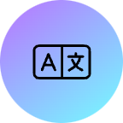


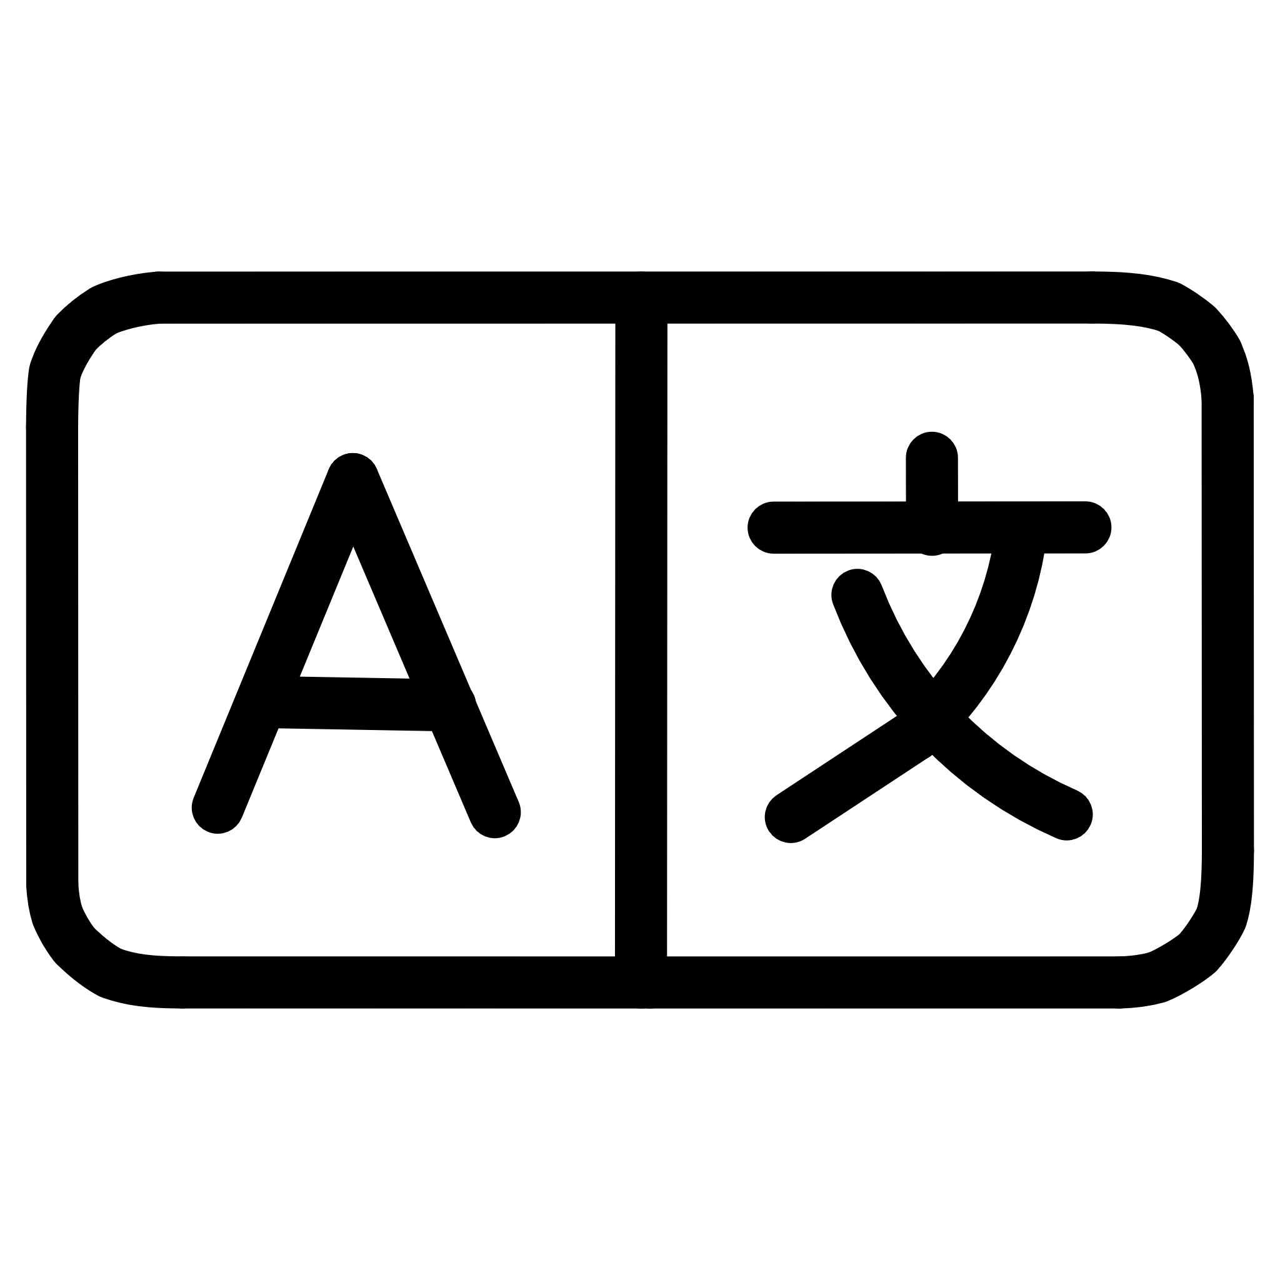


Technical Architecture
Backend Development
AI & Machine Learning
Frontend Interface
Language: Python 3.x
NLP Engine: Natural Language Processing
Technologies: HTML5, CSS3, JavaScript
Framework: Django
Core Innovation: Graph Neural Networks (GNNs)
Focus: Clean, Interactive UX
Python was chosen for its extensive machine learning library support and robust ecosystem. Django ensures a secure, scalable web architecture capable of handling sensitive legal documents with enterprise-grade security.
Designed for intuitive document viewing with interactive highlighting, pop-up explanations, and risk visualization. The interface prioritizes accessibility for non-technical users.
GNNs map the relationships between clauses, understanding how a definition in Section 1 affects a liability cap in Section 10. This contextual awareness is what sets LexGuard apart.

Slide 6
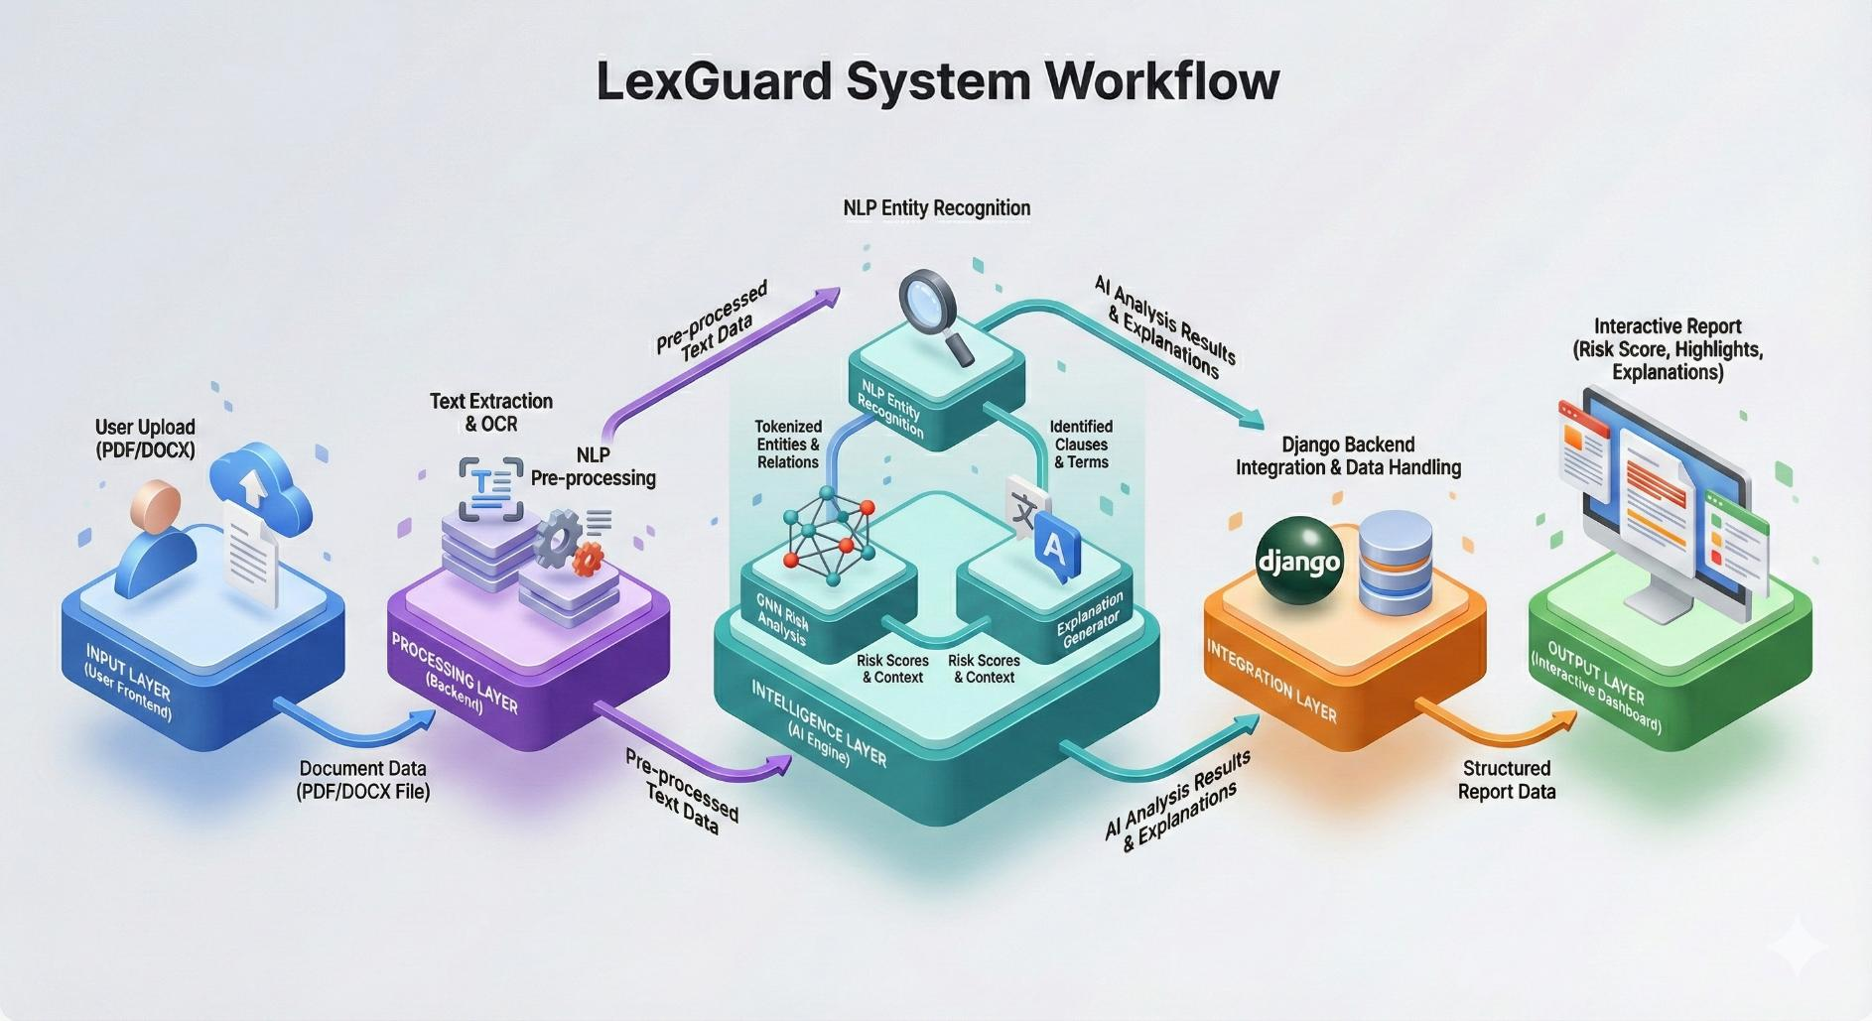
High-Level Workflow Diagram

Slide 7

Development Methodology
01
Sprint Planning
Development is broken into 2-week sprints with specific deliverables, allowing for focused work on individual components like the risk scoring engine before full system integration.
02
Iterative Development
Each sprint includes development, testing, and refinement phases. Legal interpretations are validated against real-world contract examples to ensure accuracy and reliability.
03
Parallel Workflows
Backend AI models and frontend dashboard interfaces are developed simultaneously in parallel sprints to maximize team efficiency and reduce overall project timeline.
04
Continuous Integration
Regular integration testing ensures all components work together seamlessly, catching compatibility issues early before they become major blockers.
Agile Scrum Framework
The project follows industry-standard Agile Scrum methodology, ensuring continuous improvement and adaptability throughout the development lifecycle. This approach is particularly valuable for AI projects where requirements often evolve as models are tested and refined.

Slide 8

TIMELINE
3-Month Project Execution Plan
Month 1: Foundation
Month 3: Integration & Launch
Requirement Analysis: Defining comprehensive scope, user stories, and acceptance criteria
System Integration: Connecting Django backend with AI engine and establishing API endpoints
Data Collection: Curating a labeled dataset of legal contracts spanning multiple domains for training
UI Development: Building interactive report dashboard with document viewer
Testing & QA: Comprehensive testing including accuracy validation, security audits, and user acceptance testing
NLP Pipeline: Building text extraction, cleaning, and preprocessing infrastructure
Architecture Design: Creating system design documents and database schemas
Deployment: Final production deployment and documentation
1
2
3
Month 2: Core Development
Entity Recognition: Developing the named entity recognition system for legal terms
GNN Implementation: Training Graph Neural Networks for context analysis and relationship mapping
Risk Scoring: Creating algorithms to calculate clause-level and document-level risk scores
Explainer Logic: Building the translation layer between legal terms and plain English

Slide 9
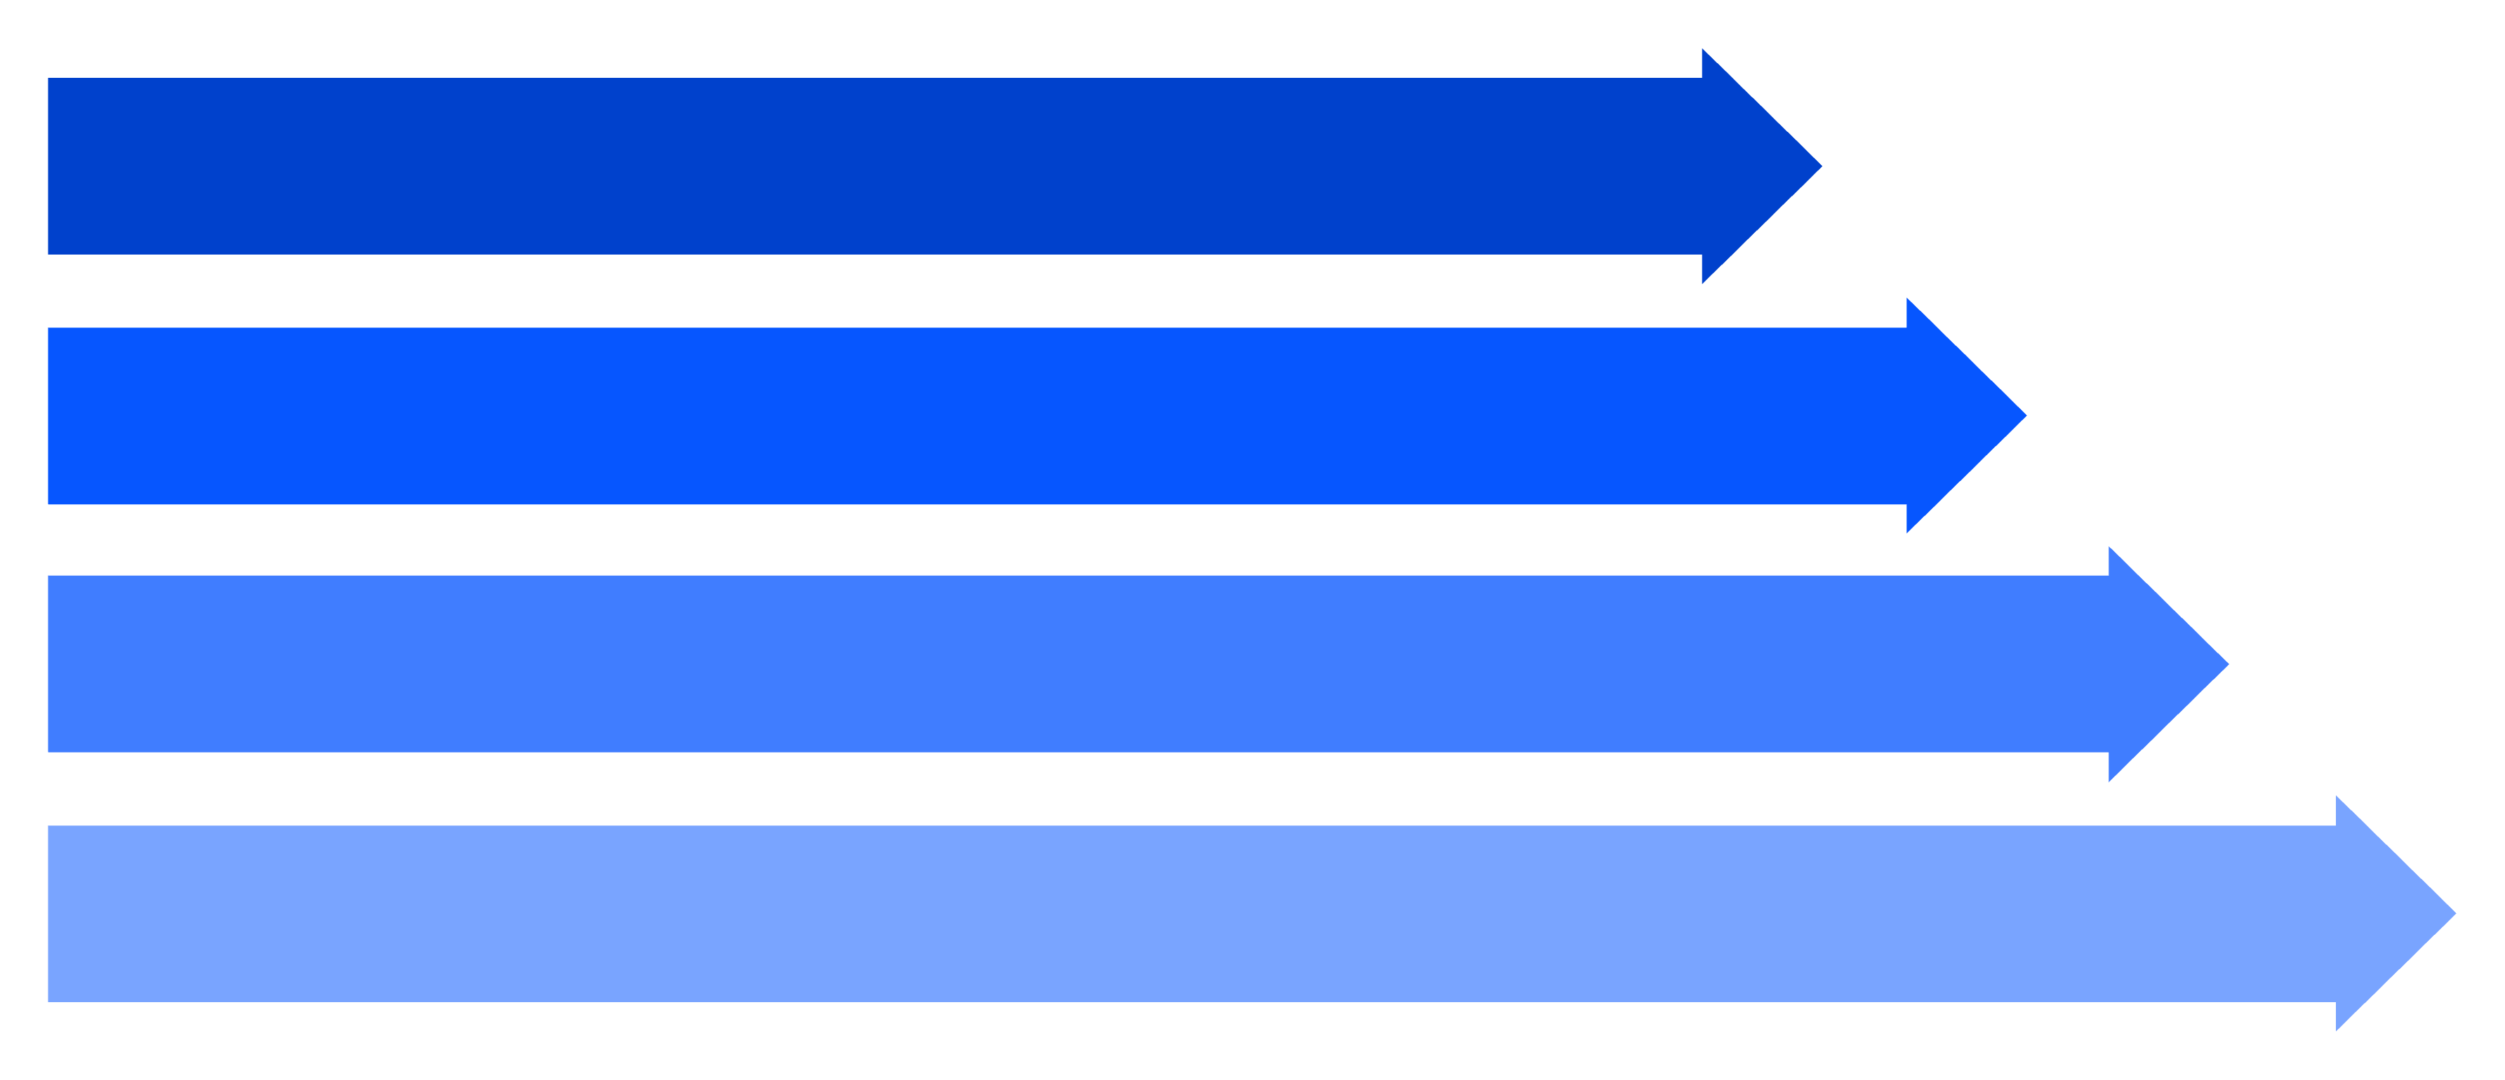
System Workflow Architecture
Input Layer
Processing Layer
Intelligence Layer
Output Layer
Input Layer
Processing Layer
User uploads contract file (PDF/DOCX) via secure web interface with encrypted
transmission
OCR converts to text; NLP tokenizes and identifies legal entities (dates, monetary
values, parties)
Intelligence Layer
Output Layer
GNN analyzes clause relationships and calculates risk scores; context engine
generates plain-English summaries
System generates interactive report highlighting risky sections with overlaid
simplified explanations

Slide 10
Expected Project Deliverables
Functional Web Application
1
A fully deployed, secure platform with user authentication, document storage, and real-time analysis capabilities. Users can create accounts, upload multiple contracts, and access their analysis history from any device.
AI Analysis Engine
2
A robust backend model capable of detecting specific legal risks across multiple contract types (employment, rental, service, NDA, partnership). The engine assigns context-aware risk scores ranging from low to critical severity.
Interactive Report Interface
3
A user-friendly document viewer that highlights dangerous terms in red/orange color coding and provides on-hover pop-up explanations in simple, conversational language. Includes downloadable PDF reports with recommendations.
Validation & Accuracy Report
4
Comprehensive testing documentation demonstrating the model's precision and recall in correctly identifying risks across a diverse test dataset. Includes confusion matrices, F1 scores, and real-world case study validations.

Slide 11


Impact & Future Vision
Social Impact
LexGuard addresses a critical gap in legal accessibility, protecting non-experts from predatory contracts and information asymmetry. This project has the potential to prevent financial exploitation and empower thousands of individuals.
Technical Merit
Demonstrates advanced competency in full-stack development (Django), cutting-edge AI (Graph Neural Networks), and real-world NLP applications. Showcases ability to integrate multiple complex technologies.
Future Enhancements
Potential expansions include multi-language support, contract comparison features, clause negotiation suggestions, integration with e-signature platforms, and mobile applications for on-the-go analysis.
"By combining robust software engineering with semantic AI, LexGuard transforms the way individuals interact with the law—making justice more accessible, one contract at a time."
Project Significance
This project bridges the gap between legal expertise and everyday users, demonstrating how AI can serve social good while showcasing technical excellence in machine learning and software development.

